Slide 1
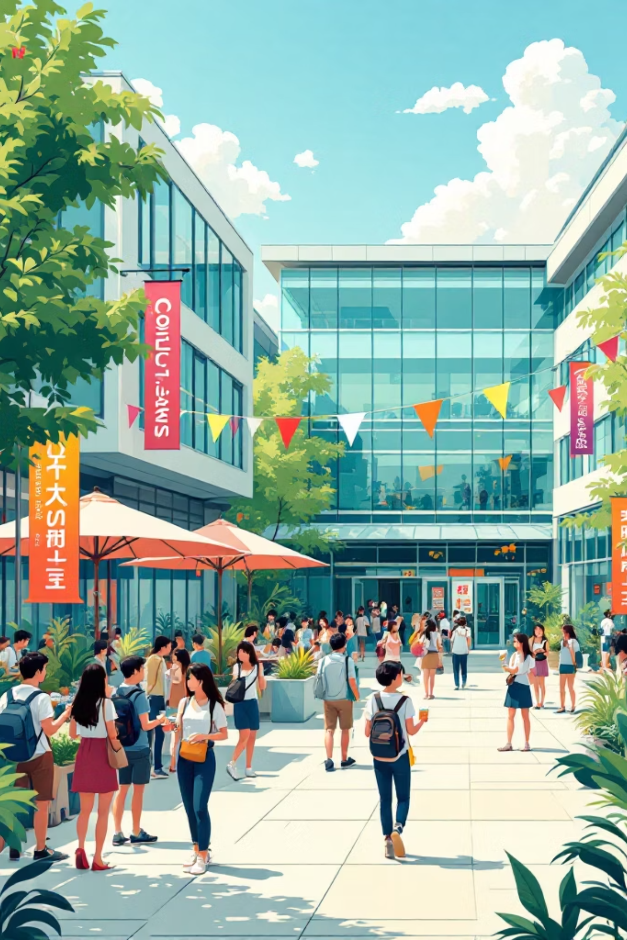
CampusEventHub
A full-featured event management platform built for college students, organizers, and admins — making campus life easier to plan, join,search,attend and manage events.
INFOSYS SPRING BOARD INTERNSHIP PROJECT
BY TEAM 3

Slide 2

The Problem We're Solving
College events — hackathons, sports, cultural fests — are often organized through scattered WhatsApp groups, Google Forms, and notice boards. Students miss out, organizers lose track, and admins have no visibility.
For Students
For Organizers
Hard to discover events, track registrations, or get updates in one place.
No centralized tool to create, manage, and promote campus events.
No oversight on event approvals, attendance, or campus activity.

Slide 3
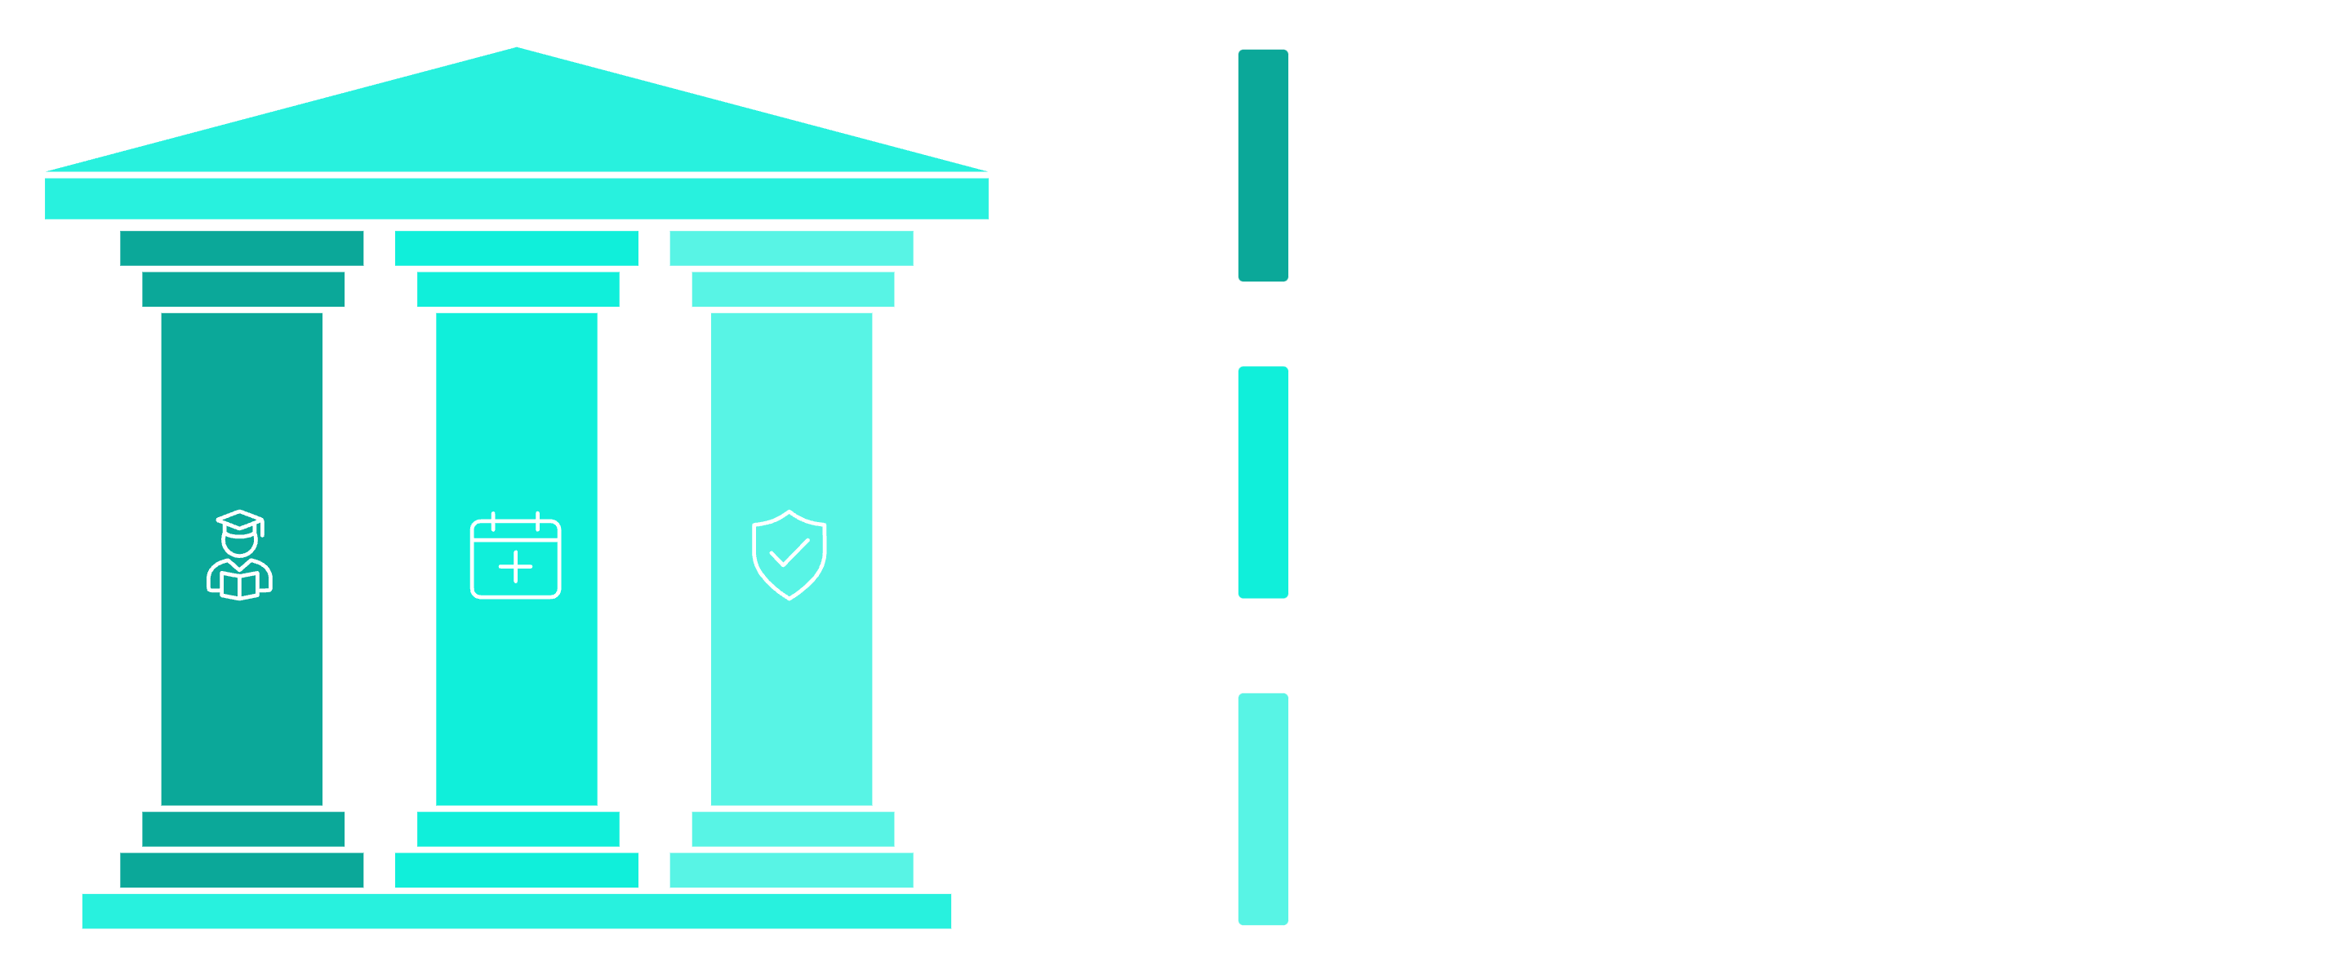
Meet CampusEventHub
One platform. Three roles. Zero chaos. CampusEventHub is a web-based event management system that connects students, event organizers, and university admins — streamlining how campus events are created, discovered, and managed.
Students
Discover, register, and track campus events
Organizers/Admins
Create, publish, and manage event listings.
Approve events and oversee campus activity
who is Admin?
anyone with valid emailID and college who wants to organize or host a event with authorites permission.
Each user type has a tailored experience, ensuring the right tools for the right people.

Slide 4
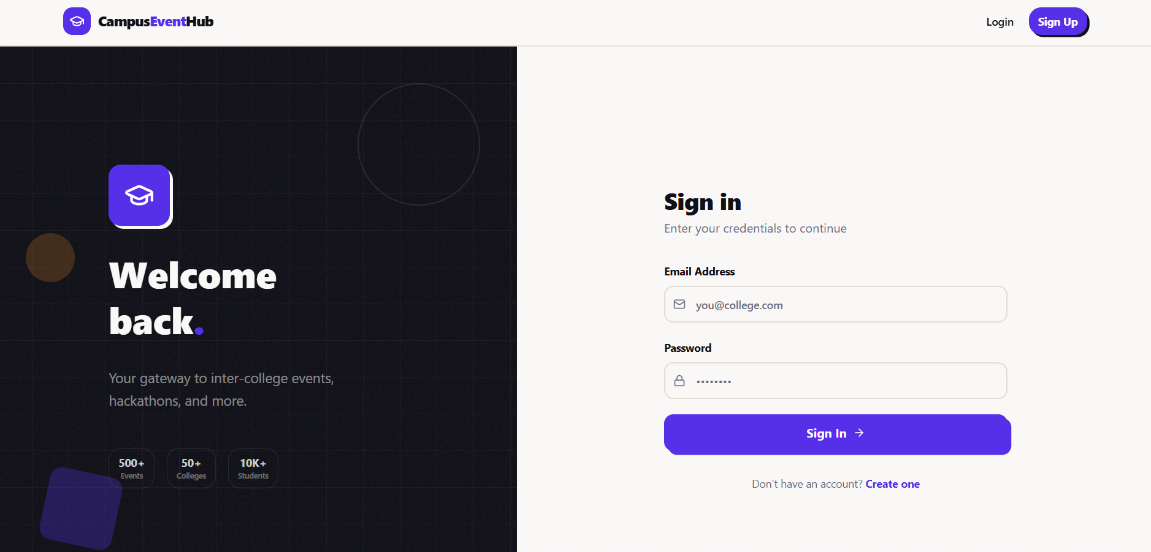
Getting Started: Landing, Login & Signup
Landing Page
A clean, welcoming homepage that introduces the platform and directs users to login or sign up — the first touchpoint for every visitor.
Authentication Flow
Secure login and registration pages with form validation ensure only verified students and staff can access the platform. Role-based access is assigned at signup.

Slide 5
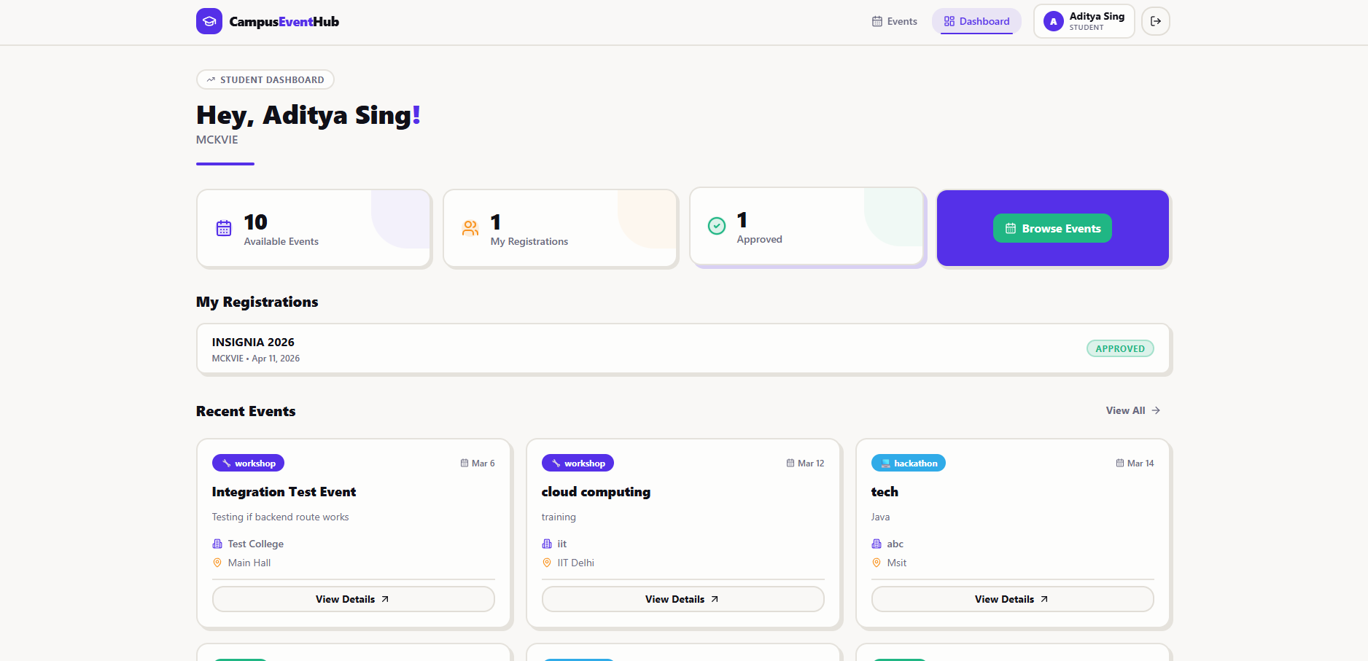
Student Dashboard
Once logged in, students land on a personalized dashboard showing upcoming events, their registrations, and quick actions — all in one view.
Event Feed
Registration Status
Quick Actions
Register, filter, or explore
events without
leaving the dashboard.
Browse all active campus events at a glance with key details like date, location, and category.
Track which events you're registered for
and see approval status instantly.
Notes:
• Start by explaining what students see when they first log in — a personalized dashboard that brings everything together in one place • Highlight the three key features: Event Feed: Students can browse all active campus events at a glance. Point out how they can quickly see important details like date, location, and what category each event falls under Registration Status: They can easily track which events they're already signed up for and check the approval status right away — no need to dig through emails or notifications Quick Actions: Everything they need to do — register, filter by interests, or explore new events — is accessible without navigating away from the dashboard • Emphasize the convenience factor: this centralized view saves time and keeps students informed about what's happening on campus

Slide 6
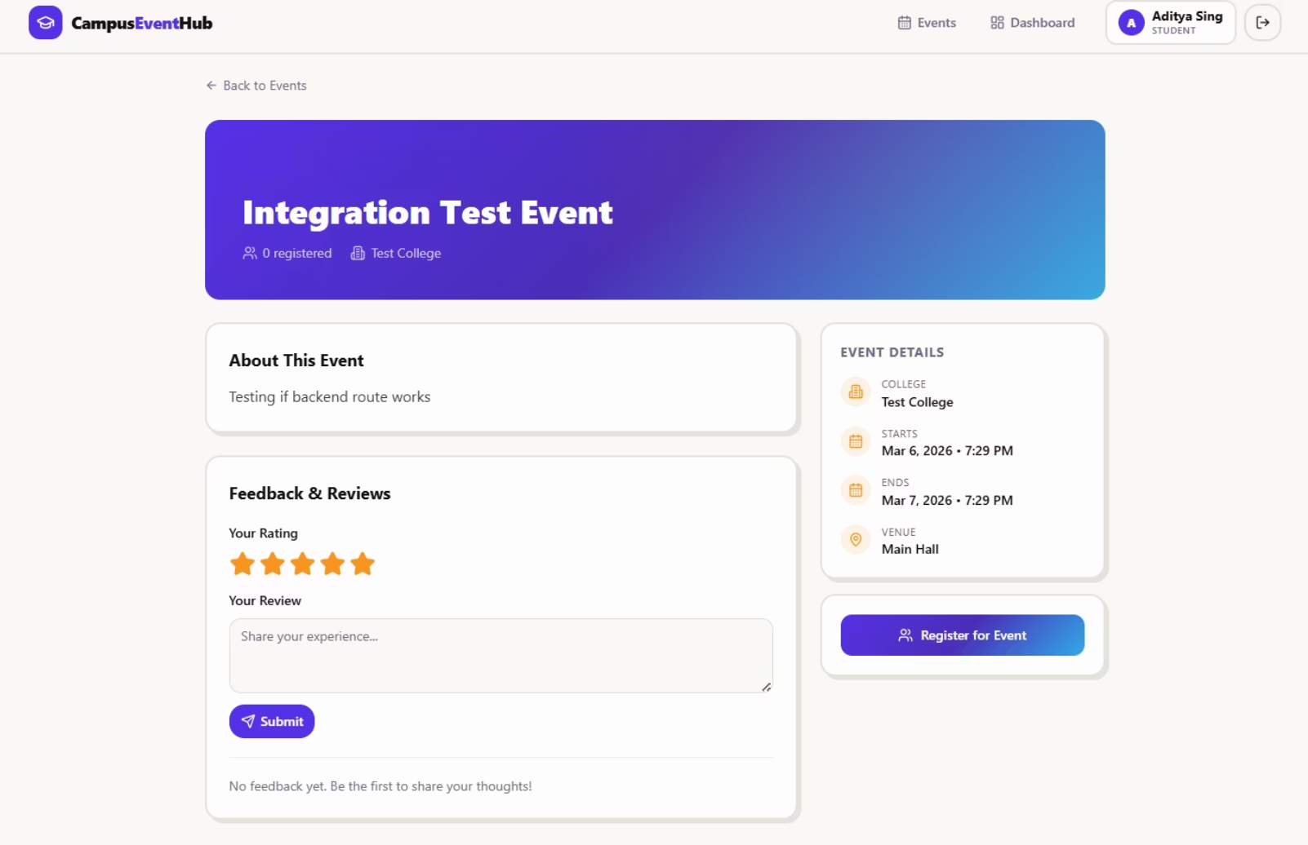
Event Details & Registration
Everything You Need Before You Register
Each event page displays full details — title, description, date, venue, organizer info, and capacity — so students can make informed decisions.
Clear event description and rules
Date, time, and location details
One-click registration button
Instant confirmation on successful signup

Slide 7
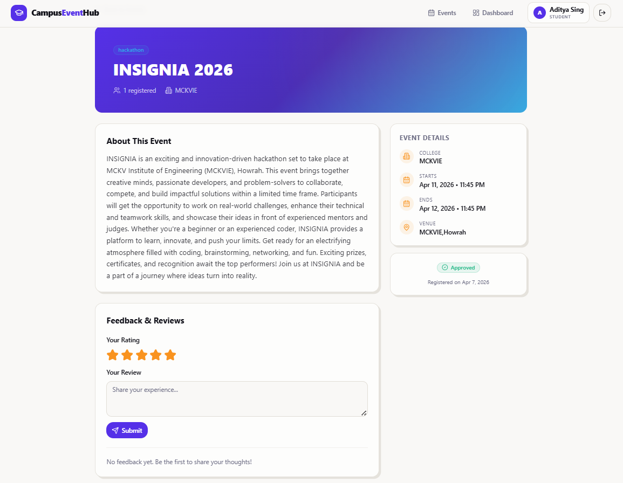
Your Registration, Confirmed
After registering, students can view their approved events in a dedicated section — a simple, clear record of everything they're signed up for. No more guessing or digging through emails.
✅ Registered
🔔 Approved
Event appears in your dashboard immediately after signup.
Organizer or admin approval is reflected in real time.
📋 Tracked
All your events in one place — no missed deadlines.

Slide 8
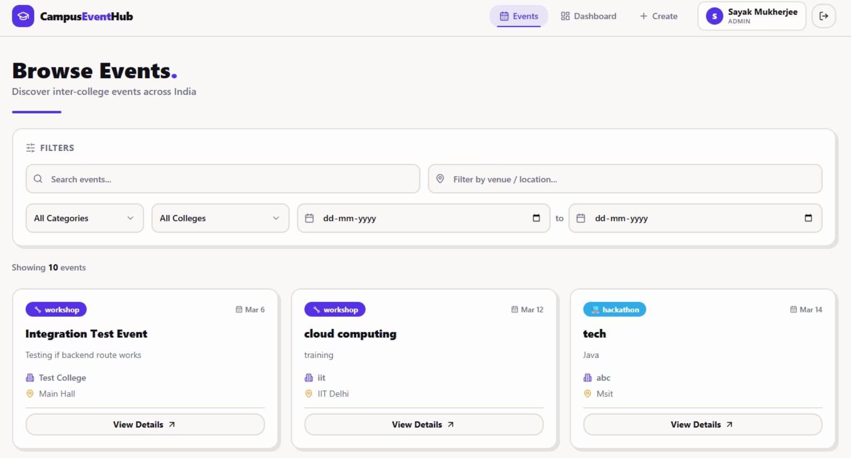
Smart Event Filters
Find Exactly What You're Looking For
With dozens of events happening across campus, smart filters help students narrow down by category, date, or type — so they never miss what matters to them.
Filter by event category (Hackathon, Sports, Cultural, etc.)
Search by keyword or event name
Sort by date or popularity

Slide 9
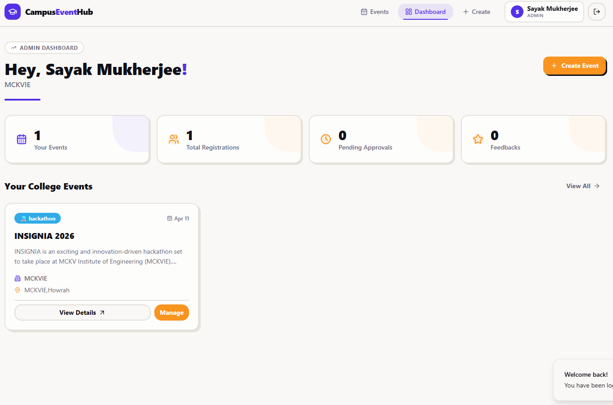
Admin Dashboard
University admins and event organizers get a powerful control panel to oversee all campus activity — from approving events to monitoring registrations.
University admins and event organizers get a powerful control panel to oversee all campus activity — from approving events to monitoring registrations.
Approve Events
Review and approve event submissions
before they go live on the platform.
Manage Users
Oversee student and organizer
accounts with role-based permissions.
Platform Overview
Get a bird's-eye view of all events,
registrations, and campus engagement.

Slide 10
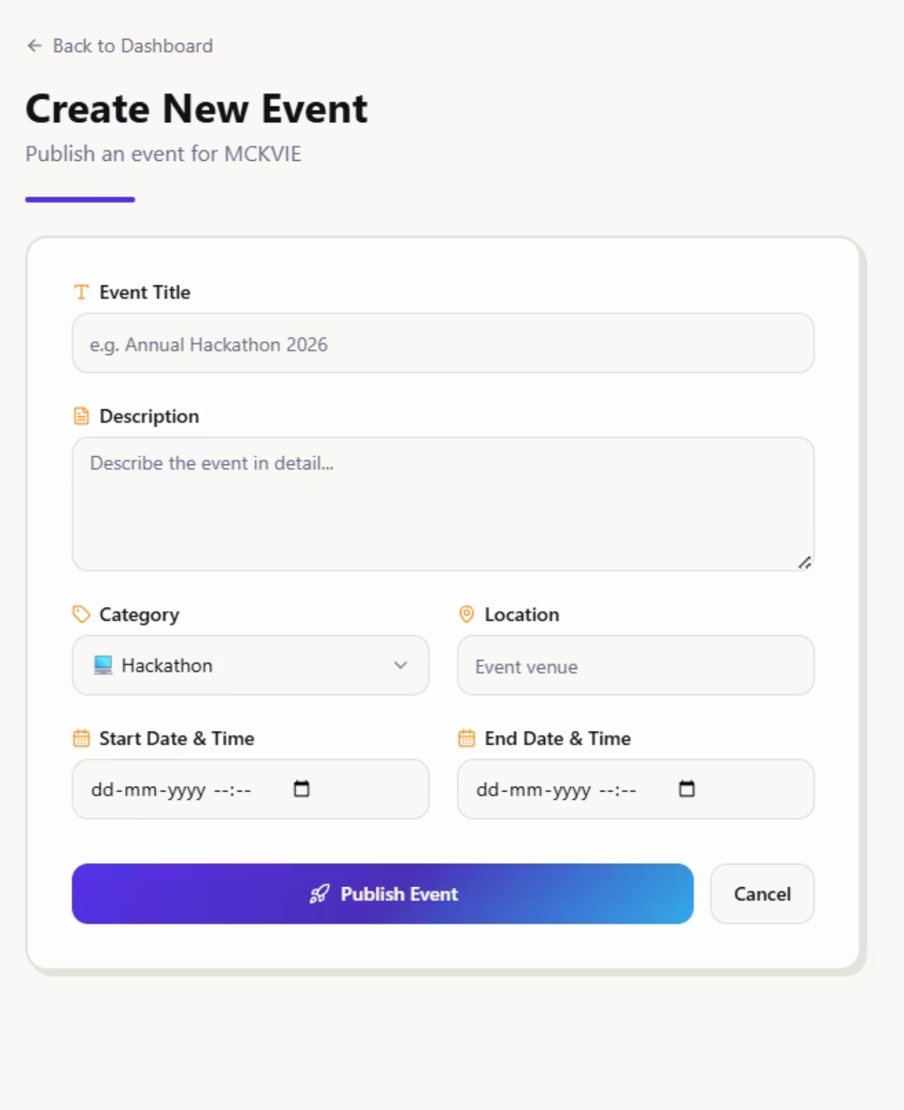

Create Events & Tech Stack
Event Creation Flow
Organizers fill in event details — name, description, date, category, and capacity — and submit for admin approval. Simple, fast, and structured.
🛠 Tech Stack
Frontend: HTML ,React js , TailwindCSS,
Backend: Node.js, Express, rest APIs
Database: MongoDB
Auth: JWT-based authentication
bcrypt → Password hashing
Full project available on GitHub — built and tested end-to-end during internship.

Slide 11
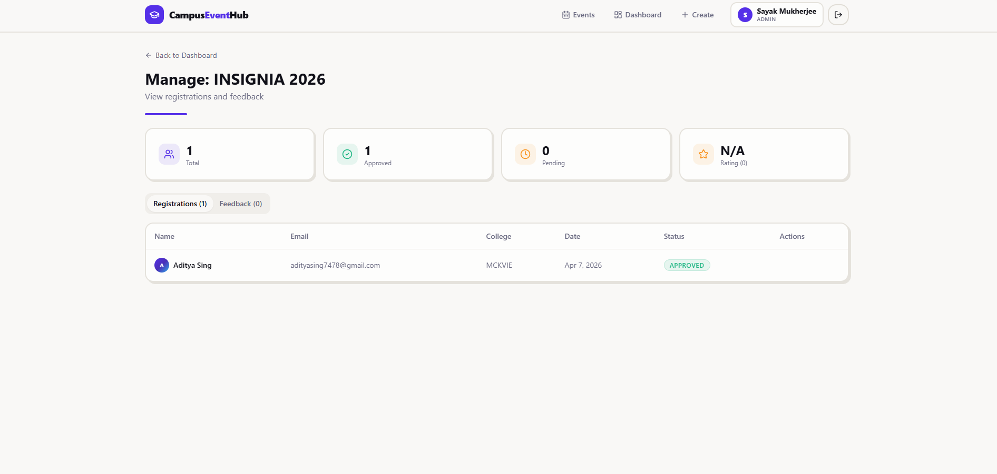
Approval Page

Slide 12
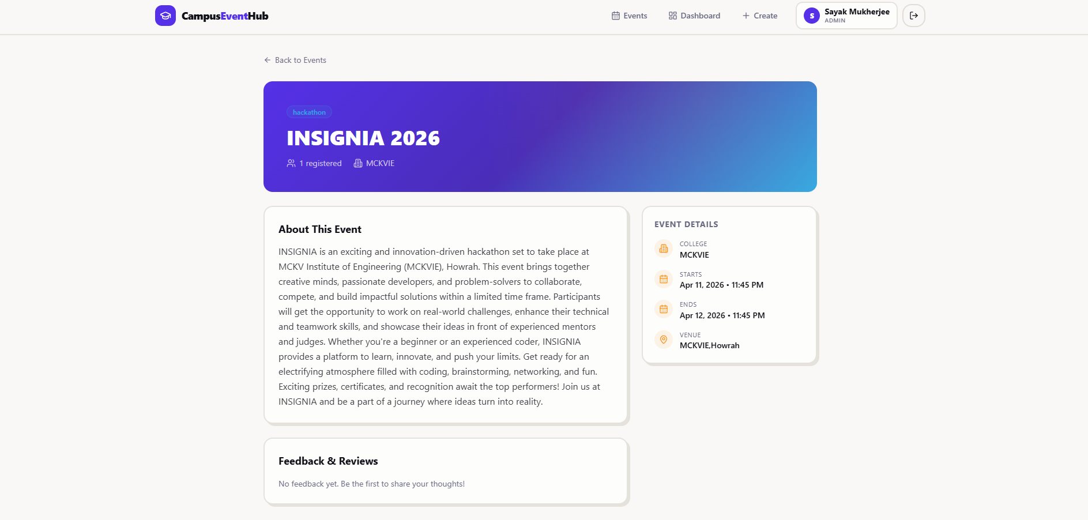
Managing Event Page

Slide 13
Created Events will show like this

Slide 14
Student dashboard

Slide 15
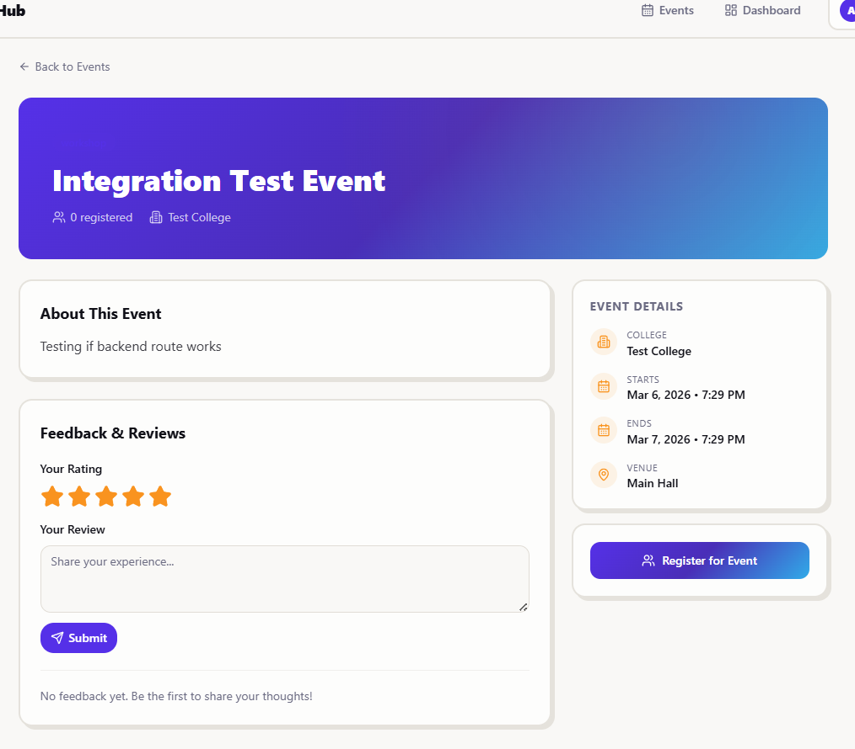
Registering for events

Slide 16
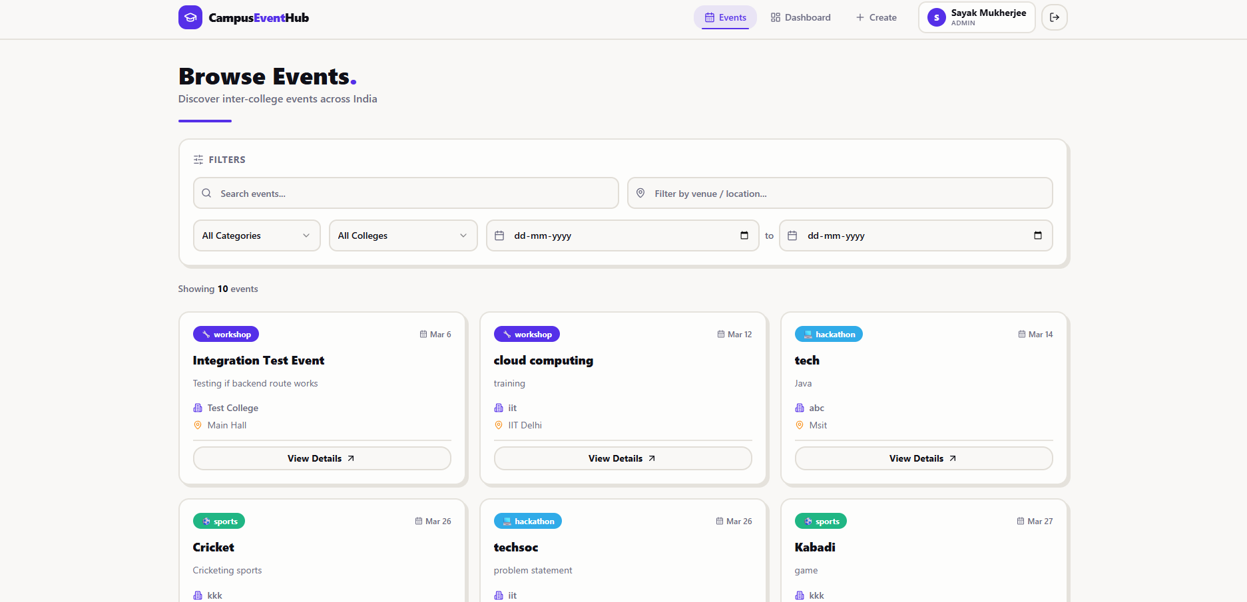
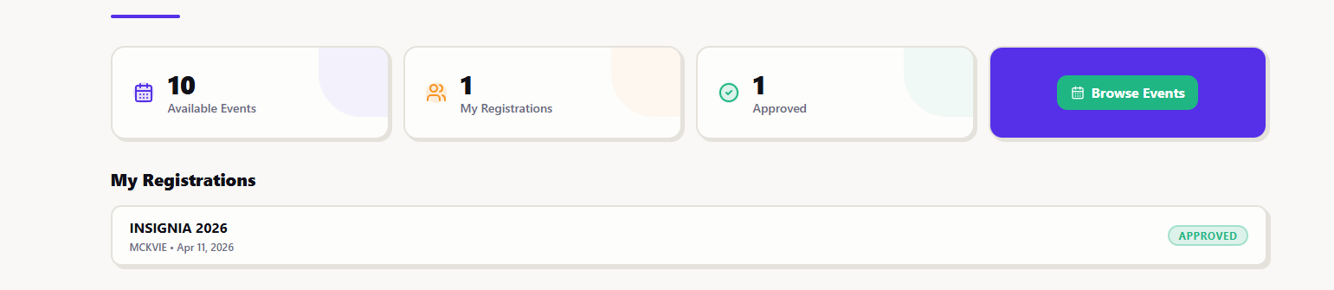
Smart Event Filters for students too

Slide 17
Thank you

